Slide 1


DESIGN • VLSI • VERILOG HDL
Design & Implementation using Verilog HDL
8-Bit Arithmetic Logic Unit (ALU)
Submitted by : Vaibhav Shromani
Branch: Electronics & Communication Engineering
Institute: Maulana Azad National Institute Of Technology
Internship: Vlsi Design- Technnglobal Industial Training Program
Github Repository: https://github.com/vaibhavshromani/8_bit_ALU

Slide 2
Table of Contents
Project Documentation Overview
01
Project Overview & Objectives
09
Test Vector Analysis
10
RTL Schematic — Xilinx Vivado
02
ALU Architecture & Operations
11
Simulation Waveform Results
03
Verilog HDL Design Implementation
12
Power Reports
04
Sub-Module Design (Adder, Logic, Shifter)
05
Top Level Module (alu_top.v)
13
Utilization Reports
06
Project Report
14
Top Level Module (alu_top.v)
07
Conclusion & Future Scope
15
Modular Architecture
08
Verification Strategy
8-Bit ALU | Vaibhav Shromani | Table of Contents

Slide 3
Project Overview & Objectives
What is an ALU?
An Arithmetic Logic Unit (ALU) is the core computational component of any processor. It performs arithmetic and logical operations on binary data. An 8-bit ALU processes operands that are 8 bits wide, making it a foundational building block in digital design and embedded systems.
Project Objectives
Design an 8-bit ALU supporting 8 distinct operations using Verilog HDL
Implement a modular, scalable architecture with separate sub-modules per operation
Verify functionality through a self-checking testbench covering all opcodes
Synthesize and analyze the design in Xilinx Vivado with power & utilization reports
Document RTL schematic, simulation waveforms, and verification results

Slide 4

INPUTS, OPERATIONS & OUTPUTS
ALU Architecture & Signal Flow
Port Specification
SEL Opcode Map
Port | Width | Dir. | Description
A[7:0] | 8-bit | Input | Operand A
B[7:0] | 8-bit | Input | Operand B
SEL[2:0] | 3-bit | Input | Operation selector (opcode)
RESULT[7:0] | 8-bit | Output | Computed result
CARRY | 1-bit | Output | Carry / Borrow output
ZERO | 1-bit | Output | High when RESULT = 0
SEL | Op | Expression
3'b000 | ADD | A + B (with COUT)
3'b001 | SUB | A − B (with BORROW)
3'b010 | AND | A & B
3'b011 | OR | A | B
3'b100 | XOR | A ^ B
3'b101 | NOT | ~A
3'b110 | SHL | A << 1
3'b111 | SHR | A >> 1
Flags: CARRY mirrors the adder COUT / subtractor BORROW for ADD and SUB only. ZERO asserts (combinationally) whenever RESULT == 8'b00000000.

Slide 5

TOP-LEVEL MODULE
Verilog HDL Design — alu_top.v
module alu_top(
input [7:0] A,
input [7:0] B,
input [2:0] SEL,
output reg [7:0] RESULT,
output reg CARRY,
output ZERO
);
wire [7:0] sum, diff, and_out, or_out;
wire [7:0] xor_out, not_out, shl_out, shr_out;
wire add_carry, sub_borrow;
adder U1(.A(A), .B(B), .SUM(sum), .COUT(add_carry));
subtractor U2(.A(A), .B(B), .DIFF(diff),
.BORROW(sub_borrow));
and_gate U3(.A(A), .B(B), .Y(and_out));
or_gate U4(.A(A), .B(B), .Y(or_out));
xor_gate U5(.A(A), .B(B), .Y(xor_out));
not_gate U6(.A(A), .Y(not_out));
shifter U7(.A(A), .dir(1'b0), .Y(shl_out));
shifter U8(.A(A), .dir(1'b1), .Y(shr_out));
always @(*) begin
CARRY = 0;
case(SEL)
3'b000: begin RESULT = sum;
CARRY = add_carry; end
3'b001: begin RESULT = diff;
CARRY = sub_borrow; end
3'b010: RESULT = and_out;
3'b011: RESULT = or_out;
3'b100: RESULT = xor_out;
3'b101: RESULT = not_out;
3'b110: RESULT = shl_out;
3'b111: RESULT = shr_out;
default: RESULT = 8'b0;
endcase
end
// Zero Flag Assignment
assign ZERO = (RESULT == 8'b00000000);
endmodule

Slide 6
Verilog HDL Design — alu_top_tb.v
`timescale 1ns / 1ps
module alu_tb;
reg [7:0] A;
reg [7:0] B;
reg [2:0] SEL;
wire [7:0] RESULT;
wire CARRY;
wire ZERO;
alu_top uut (
.A(A),
.B(B),
.SEL(SEL),
.RESULT(RESULT),
.CARRY(CARRY),
.ZERO(ZERO) );
task show;
input [23:0] op_name;
begin
$display("%-6s | A=%h B=%h | RESULT=%h CARRY=%b ZERO=%b", op_name, A, B, RESULT, CARRY, ZERO);
end
endtask
initial begin
// Initialize everything to 0 first
A = 8'h00; B = 8'h00; SEL = 3'b000;
#10; // wait for signals to settle $display("==========================================");
$display(" 8-BIT ALU TESTBENCH RESULTS"); $display("==========================================");
// ══ SEL=000 : ADD ══════════════════════
$display("--- ADD ---");
SEL = 3'b000;
A = 8'h0F; B = 8'h0F; #20; show("ADD"); // 0F+0F=1E
A = 8'hFF; B = 8'h01; #20; show("ADD"); // overflow CARRY=1
A = 8'h00; B = 8'h00; #20; show("ADD"); // ZERO=1
#50;
// ══ SEL=001 : SUB ══════════════════════
$display("--- SUB ---");
SEL = 3'b001;
A = 8'hFF; B = 8'h01; #20; show("SUB"); // FF-01=FE
A = 8'h0A; B = 8'h05; #20; show("SUB"); // 0A-05=05
A = 8'h00; B = 8'h01; #20; show("SUB"); // borrow CARRY=1
#50;
// ══ SEL=010 : AND ══════════════════════
$display("--- AND ---");
SEL = 3'b010;
A = 8'hFF; B = 8'hF0; #20; show("AND"); // F0
A = 8'hAA; B = 8'h55; #20; show("AND"); // 00 ZERO=1
A = 8'h0F; B = 8'hF0; #20; show("AND"); // 00 ZERO=1
#50;
// ══ SEL=011 : OR ═══════════════════════
$display("--- OR ---");
SEL = 3'b011;
A = 8'hAA; B = 8'h55; #20; show("OR"); // FF
A = 8'h0F; B = 8'hF0; #20; show("OR"); // FF
A = 8'h00; B = 8'h00; #20; show("OR"); // 00 ZERO=1
#50;
// ══ SEL=100 : XOR ══════════════════════
$display("--- XOR ---");
SEL = 3'b100;
A = 8'hFF; B = 8'hFF; #20; show("XOR"); // 00 ZERO=1
A = 8'hAA; B = 8'h55; #20; show("XOR"); // FF
A = 8'hF0; B = 8'h0F; #20; show("XOR"); // FF
#50;
// ══ SEL=101 : NOT ══════════════════════
$display("--- NOT ---");
SEL = 3'b101;
A = 8'hAA; B = 8'h00; #20; show("NOT"); // 55
A = 8'hFF; B = 8'h00; #20; show("NOT"); // 00 ZERO=1
A = 8'h00; B = 8'h00; #20; show("NOT"); // FF
#50;
// ══ SEL=110 : SHL ══════════════════════
$display("--- SHL ---");
SEL = 3'b110;
A = 8'h0F; B = 8'h00; #20; show("SHL"); // 1E
A = 8'h01; B = 8'h00; #20; show("SHL"); // 02
A = 8'h80; B = 8'h00; #20; show("SHL"); // 00 ZERO=1
#50;
// ══ SEL=111 : SHR ══════════════════════
$display("--- SHR ---");
SEL = 3'b111;
A = 8'hF0; B = 8'h00; #20; show("SHR"); // 78
A = 8'hAA; B = 8'h00; #20; show("SHR"); // 55
A = 8'h01; B = 8'h00; #20; show("SHR"); // 00 ZERO=1
#50;
$display("==========================================");
$display(" SIMULATION COMPLETE - ALL 8 OPS DONE");
$display("==========================================");
$finish;
end
// Single monitor - no race condition
initial
$monitor("t=%0t ns | SEL=%b A=%h B=%h | RESULT=%h CARRY=%b ZERO=%b",
$time, SEL, A, B, RESULT, CARRY, ZERO);
endmodule

Slide 7
MODULAR ARCHITECTURE
Sub-Module Design — One Block Per Operation
adder.v
subtractor.v
and_gate.v
or_gate.v
assign {COUT,SUM} = A + B;
assign {BORROW,DIFF} = A - B;
assign Y = A & B;
assign Y = A | B;
8-bit ripple addition with carry-out
8-bit subtraction with borrow-out
Bitwise AND
Bitwise OR
xor_gate.v
not_gate.v
shifter.v (dir=0)
shifter.v (dir=1)
assign Y = A ^ B;
assign Y = ~A;
assign Y = A << 1;
assign Y = A >> 1;
Bitwise XOR
Bitwise inversion of A
Logical left shift
Logical right shift

Slide 8
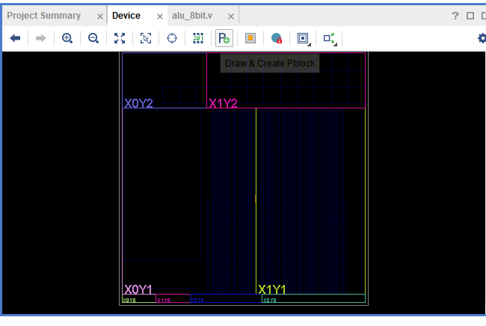
VERIFICATION STRATEGY
Testbench Design — alu_tb.v
Opcode Coverage
ADD
3 vectors — incl. carry-out & zero
SUB
3 vectors — incl. borrow & zero
AND
3 vectors — incl. zero
OR
3 vectors — incl. zero
XOR
3 vectors — incl. zero
NOT
3 vectors — incl. zero
SHL
3 vectors — incl. zero
SHR
3 vectors — incl. zero

Slide 9
TEST VECTOR ANALYSIS
Waveform Analysis & Verification
Op | SEL | A | B | Result | Carry | Zero | Status
ADD | 3'b000 | 0x0F | 0x0F | 0x1E | 0 | 0 | PASS
ADD | 3'b000 | 0xFF | 0x01 | 0x00 | 1 | 1 | PASS
SUB | 3'b001 | 0xFF | 0x01 | 0xFE | 0 | 0 | PASS
SUB | 3'b001 | 0x00 | 0x01 | 0xFF | 1 | 0 | PASS
AND | 3'b010 | 0xAA | 0x55 | 0x00 | 0 | 1 | PASS
XOR | 3'b100 | 0xFF | 0xFF | 0x00 | 0 | 1 | PASS
NOT | 3'b101 | 0xAA | — | 0x55 | 0 | 0 | PASS
SHL | 3'b110 | 0x80 | — | 0x00 | 0 | 1 | PASS
SHR | 3'b111 | 0x01 | — | 0x00 | 0 | 1 | PASS
Key Observations
All nine test vectors across the eight opcodes produce correct results
ZERO flag correctly asserts whenever RESULT == 0 (AND, XOR, SHL, SHR cases)
CARRY mirrors adder COUT on overflow and subtractor BORROW on underflow

Slide 10
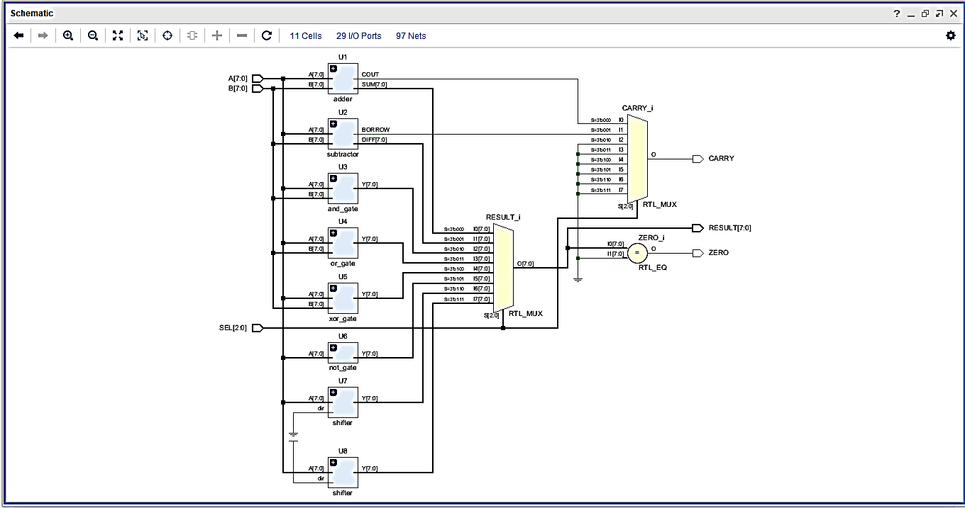
SYNTHESIZED VIEW
RTL Schematic — Xilinx Vivado
11 Cells | 29 I/O Ports | 97 Nets — eight operation sub-modules feeding two output multiplexers (RESULT, CARRY) and a zero comparator.

Slide 11
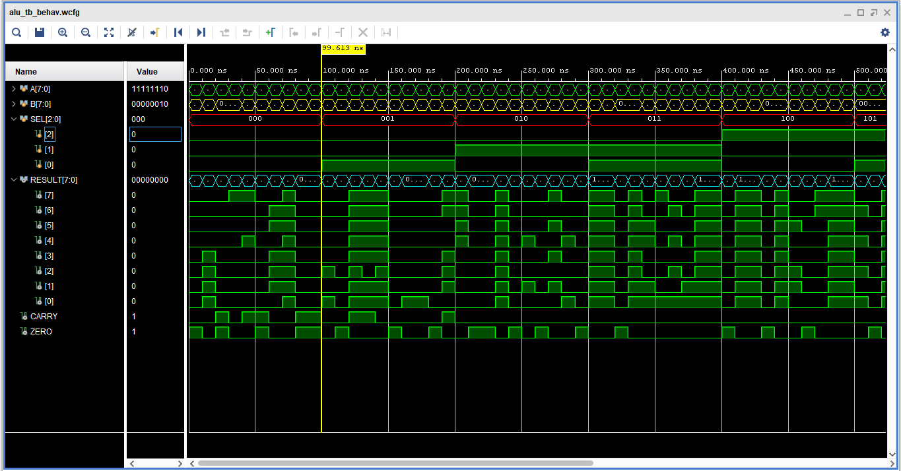
FUNCTIONAL VERIFICATION
Simulation Waveform Results
ADD
0F+0F=1E
SUB
FF-01=FE
AND
AA&55=00, Z=1
OR
0F|F0=FF
XOR
F0^0F=FF

Slide 12
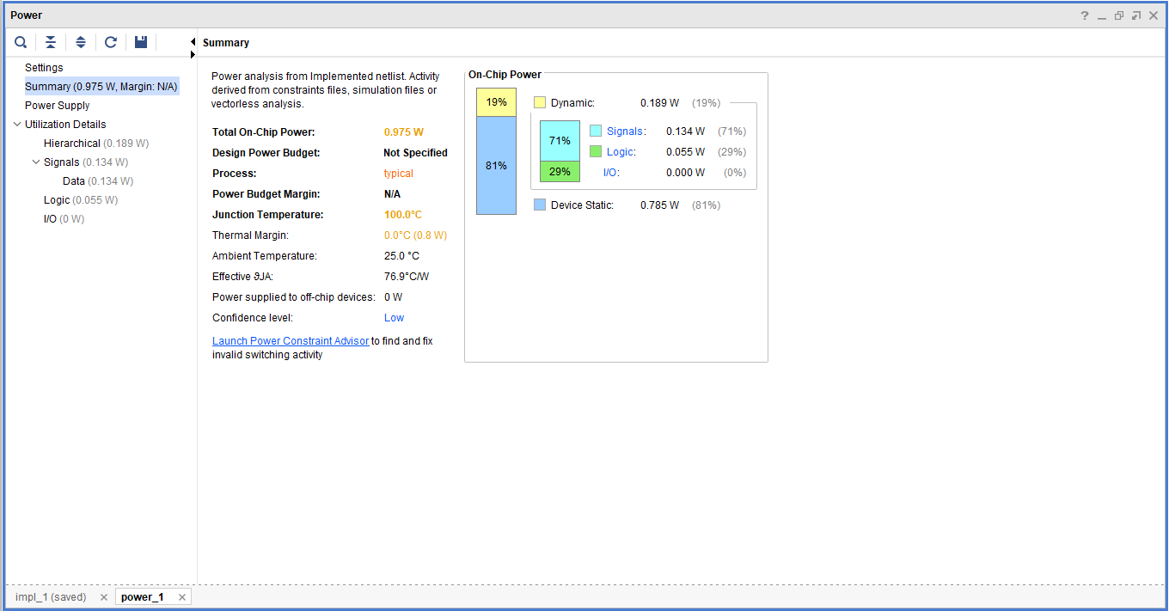
VIVADO IMPLEMENTATION REPORTS
Power Report
Power Summary
Category | Value | Share
Total On-Chip | 0.975 W | 100%
Dynamic | 0.189 W | 19%
• Signals | 0.134 W | 71% of dyn.
• Logic | 0.055 W | 29% of dyn.
Device Static | 0.785 W | 81%
Junction Temp: 100.0°C | Thermal Margin: 0.0°C (0.8 W) | Confidence: Low

Slide 13
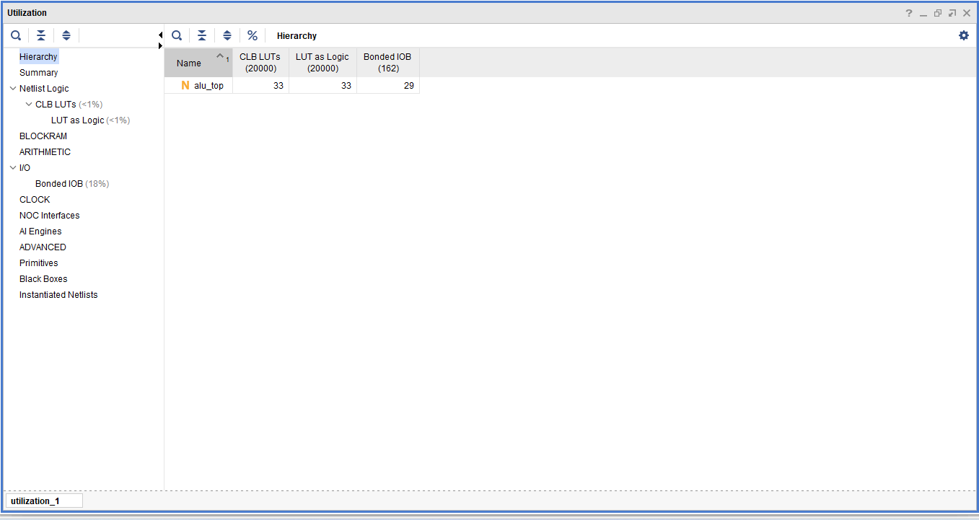
Utilization Reports
Resource Utilization
Resource | Used | Available | Util %
CLB LUTs | 33 | 20,000 | < 1%
LUT as Logic | 33 | 20,000 | < 1%
Bonded IOB | 29 | 162 | 18%
Design hierarchy: alu_top — single-level instantiation of 8 combinational sub-modules. Extremely lightweight footprint, well within a small FPGA's LUT budget.

Slide 14
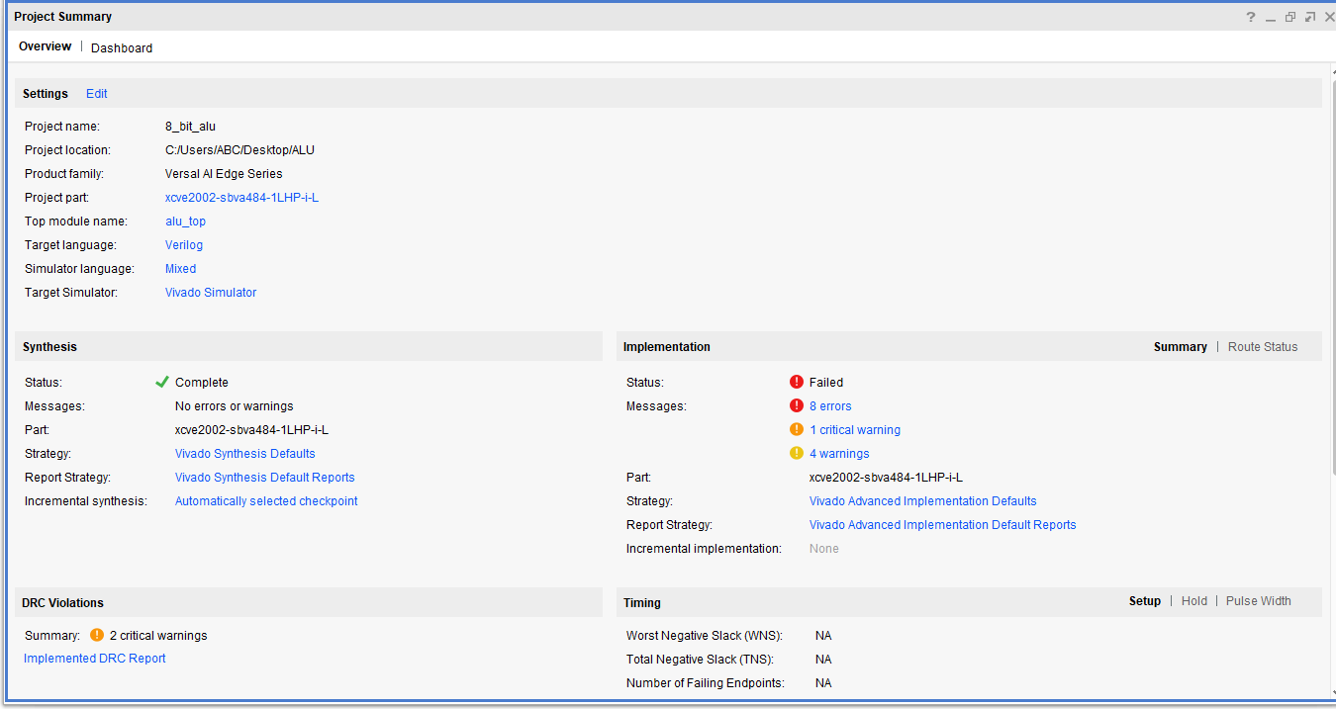
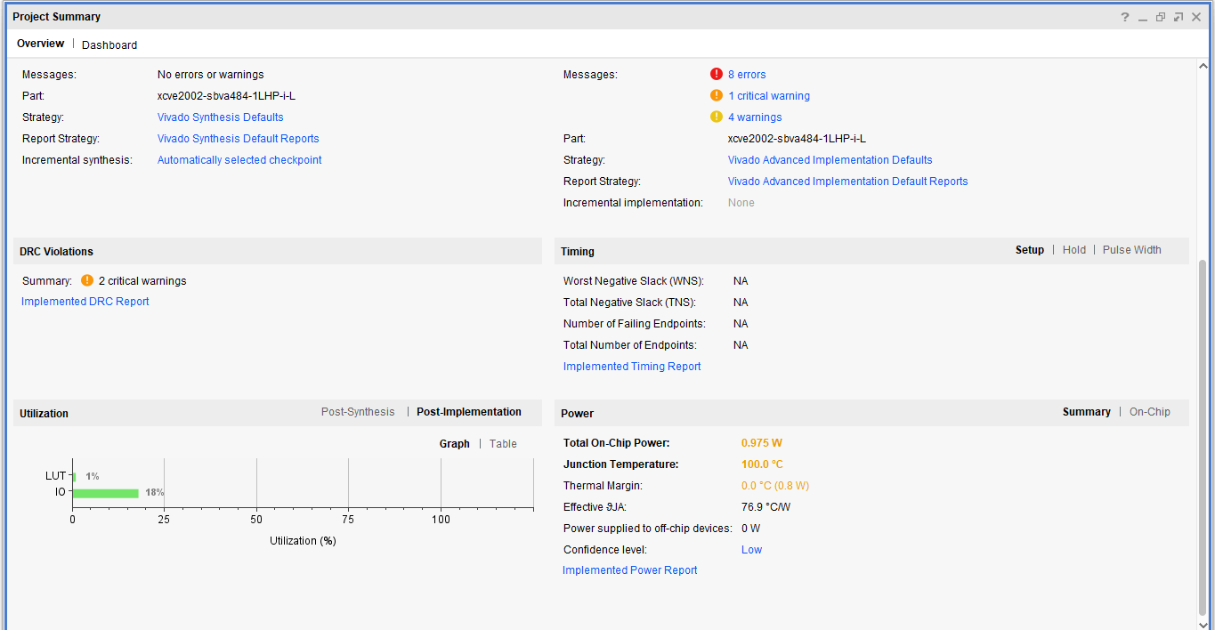
Project Summary

Slide 15
Conclusion & Future Scope
Achievements
Future Enhancements
Successfully designed an 8-bit ALU with all 8 operations.
Add more operations (e.g., multiply, rotate, arithmetic shift).
Fully verified through a self-checking Vivado testbench.
Implement control signals for signed operations.
RTL schematic, synthesis & implementation completed.
Add overflow detection.
Power analysis and resource utilization reports generated.
Create a synthesizable top module with clocked design.
Purely combinational design using always @(*).
FPGA implementation (Vivado / Quartus).

Slide 16
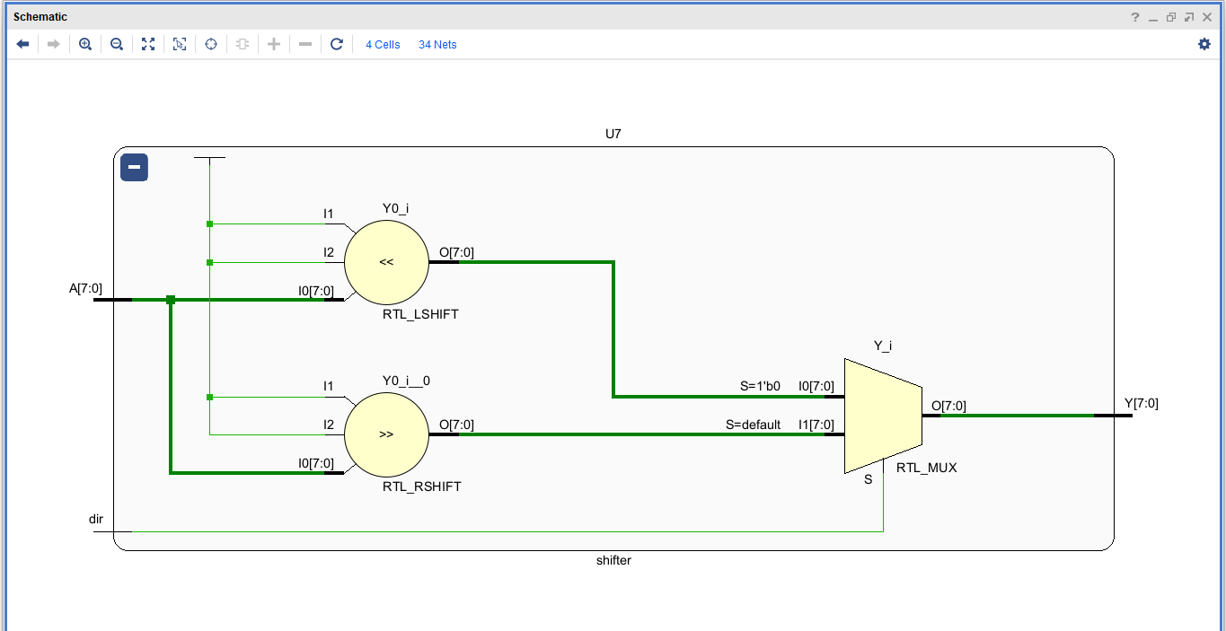
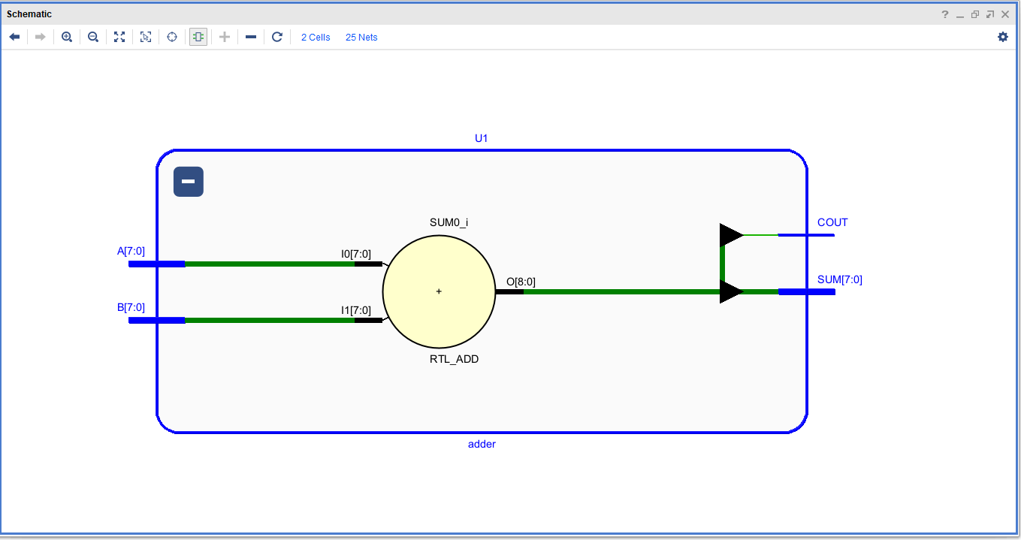

Thank You
Vaibhav Shromani
Electronics & Communication Engineering
Maulana Azad National Institute Of Technology, Bhopal
VLSI Domain – Minor Project
TechnGlobal Industrial Training Program | May-June 2026
TECHNGLOBAL PRIVATE LIMITED | info@technglobal.in | www.technglobal.in

